Slide 1
Part 4: Application Support Tools Research Issues
Anthony Steed

Slide 2
Application Support
- Security, Protocol decisions
- Persistence
Tools
- Middleware
- Networked engines
Research Issues
- Scalable peer-to-peer, thin clients
- Standards, etc.

Slide 3
Application Support

Slide 4
Application Support
- Security, Protocol decisions
- Persistence

Slide 5
SECURITY AND CHEATING

Slide 6
Overview of Security Problems
Client_{C} may be interfering with traffic
Client_{A} may be running
Compromised code
Client_{C}
Server_{X} may have
exploitable bugs
Client_{A}
Server_{X}
Client_{B}
Client_{B} may be colluding
with Client_{A}
Notes:
Figure 13.1

Slide 7
Compromised Clients
A pervasive problem in gaming
E.G. notable problems with PSNet games after the PS3 master key was found allowing modified code on the PS3
For console gaming, hardware vendors try to lock down the hardware so only verified programs can run
For PC gaming, various detection techniques such as PunkBuster that detect malicious software on the PC
Countermeasure are typically ahead of amateur cheats but not professional cheats

Slide 8
Traffic Interference
Once data is on the network it is public
Various attacks
Packet injection
Packet hiding
Latency asymmetry
Some are mitigated by secure networks
Some servers specifically support secur

Slide 9
Exploitable Server
Users need to trust server, user hosted games are not accepted for ranking tournaments or cash games
Server might be have a loophole
E.G. Dupe bugs
Denial of service attack

Slide 10
User Collusion
A very difficult social situation to counter
E.G. Chip dumping
With this and all other security problems monitoring of exceptions is important
Players being too skillful
Unlikely plays
Game inventory inflation

Slide 11
Secure Networks

Slide 12
Virtual Private Networks
Now very common for corporations and universities
Three reasons
Protection of internal services
Giving a different “appearance” to the outside world (e.g. ACM Digital Library)
Security of access from anywhere (no need to trust local network)
The very easiest way to protect a NVE or NG is to require someone go on a trusted VPN first
Incurs latency/bandwidth overhead of routing all information to the VPN access point first

Slide 13
Virtual Private Networks (VPNs)
Server_{X}
IP
Server_{Y}
Client_{A}
IP
Notes:
Figure 13.2 (Top)

Slide 14
VPNs and IPSec
Server_{X}
IP
Server_{Y}
IPSec
VPN
Gateway
Client_{A}
IP
Notes:
Figure 13.2 (Bottom)

Slide 15
STREAMING

Slide 16
Different Uses of Streaming
Streaming Protocols
Streaming Animations
Streaming Geometry (i.e. incremental download)

Slide 17
Streaming Protocols
Audio/video transport is well developed on the Internet
However “well developed” means lots of competing solutions
Several plug and play libraries
Real-Time Protocol an extension of UDP to support streaming (though not all streaming protocols use it)
Can get RTP compliant libraries which enables streaming and receiving
E.G. AccessGrid, some VoIP solutions

Slide 18
Real-Time Protocol
Bits | 0 15 |  | 16 31
0-31 | Version, config, flags | Payload Type | Sequence Number
32-63 | Timestamp
64-95 | Synchronisation Source (SSRC) Identifier
96+ | Contributing Source (CSRC) Identifiers (Optional)
96+ | Header Extensions (Optional)
96+ | Payload Header
128+ | Payload Data
Notes:
Figure 13.4

Slide 19
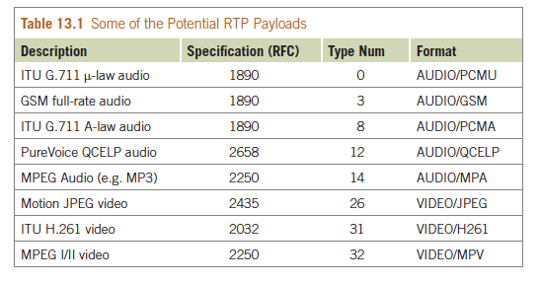
RTP Payloads
Notes:
Table 13.1

Slide 20
Streaming Animations
We have already looked at streaming positions and orientations of objects
However, a large class of objects are humans or animals (or aliens) which deform
Typically modeled from the graphics side as a skeleton
Animation is controlled by indicating which motion the character is in and the keyframe in that motion
Because motion is continuous (e.g. motion capture) information might only need to be sent > 1s

Slide 21
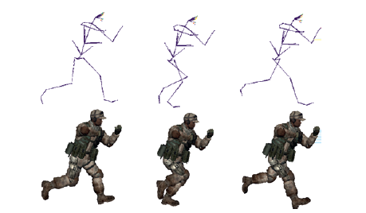
Examples of Keyframe Animation
Notes:
Figure 13.5

Slide 22
Streaming Geometry
Many NVEs use very large worlds which need to be downloaded because user modifiable or just vast
System needs to determine which parts of the models should be transferred
Typically done in a priority order from the viewpoint of the client, e.g. in increasing distance order
Two ways of doing this
Client-pull
Server-push

Slide 23
Server Push
PositionX
PositionY
Send A_{High}, B_{Low}
Position Z
Send B_{High}, C_{Low}
Send D_{Low}, E_{Low}
Client
Server
Notes:
Figure 13.6

Slide 24
Client Pull
Fetch Index
Send Index
Fetch A_{High}, B_{Low}
Fetch B_{High}, C_{Low}
Send A_{High}, B_{Low}
Send B_{High}, C_{Low}
Client
Server
Notes:
Figure 13.6

Slide 25
PERSISTENT AND TIERED SERVICES

Slide 26
Building a Persistent Service
Many systems are long-lived and worth money
Second Life
World of Warcraft
There needs to be a reliable persistent backend
There needs to be separation of concerns in web-service
The infrastructure needs to be protected
A lot of this is just based on good practice for big web services

Slide 27
What Needs to be Persistent
Player scores!
In-game currency, in-game asset ownership
Need proper “database-like” characteristics (ACID principles)
Thus use proper databases over SQL
World description
Can use database over SQL, probably more custom databases

Slide 28
What Doesn’t Need to be Persistent
Actual in-game state (usually)
Users care about outcomes, not state
No need to (e.g.) continuously store players locations to a persistent database
Commonly assumed that there is a “prototype” world-state that the world can be reset to at any point
If the world crashes, just reload it
This state might be a file on disk

Slide 29
Other Separation of Concerns
Don’t expose database to the raw Internet
Normal “tiered-service”-style approach
Separate computational processes if required
E.G. Separate physics from rest of game-play
Sometimes: don’t even let clients connect direct to game servers, use a gateway
Allows TCP connections to be kept-alive
Good point to rate-limit
Fair sharing amongst users

Slide 30
Public Network
Private Network
Physics_{A}
Master
Server
Gateway_{A}
Gameplay_{A}
Physics_{B}
Gateway_{B}
New Process
Gameplay_{B}
Database
Asset Server
Notes:
Figure 13.7

Slide 31
Tools

Slide 32
Tools
- Middleware
- Networked engines
www.networkedgraphics.org has lots of information about tools

Slide 33
ROLE OF MIDDLEWARE

Slide 34
Middleware
Network frameworks
Manage whole setup
Protocol implementations
Implement protocol such as DIS
Connection management
Manage multiple ports, streams
Operating system abstraction
Cross platform support
Operating system
E.G. “Socket” APIs

Slide 35
LOW-LEVEL SOCKET APIS

Slide 36
Address lookup functions

Slide 37
Patterns of client and server socket use for UDP and TCP

Slide 38
DIS

Slide 39
Distributed Interactive Simulation
DIS’s purpose is to inter-connect simulators, typically vehicle simulators in military simulations
DIS defines a packet, which is sent via UDP, called a PDU (Protocol Data Unit)
DIS often utilizes multicast which is a property of IP where one IP packet can be sent to multiple destinations
This requires UDP-style sending (i.e. no guarantee of receipt)
Assumed that simulators send PDUs periodically, no need for resend

Slide 40
Types of PDU

Slide 41
Entity State PDU

Slide 42
X3D AND DIS

Slide 43
X3D in a Nutshell
Notes:
Figure 7.1

Slide 44
X3D in a Nutshell
Source
Filter
Filter
Sink
Node
Routes
Notes:
Figure 7.2

Slide 45
X3D in a Nutshell
TIMER:
TimeSensor
ROTATOR: Orientation Interpolator
TRANS:
Transform
fraction_changed
set_fraction
value_changed
set_rotation
Notes:
Figure 7.3

Slide 46
X3D in a Nutshell
GLOBAL_TIMER:
TimeSensor
GLOBAL_TRANS: PositionInterpolator
BOID:
Transform
set_fraction
set_translation
fraction_changed
value_changed
translation_changed
BOID_FLAP:
Script
BOID_TIMER:
TimeSensor
BOID_INTERP:
Coordinate Interpolator
BOID_COORDS:
Coordinate
set_position
set_loop
set_fraction
set_point
isFlapping
startTime
flapTime
fraction_changed
value_changed
Notes:
Figure 7.4

Slide 47
X3D, HAWKNL AND DIS

Slide 48
HawkNL
A very simple library (Hawk Software) that isolates operating system differences between UNIX and Windows

Slide 49
Idea
Take a boids simulator that simulates a flock of boids
Have this write one DIS packet to the network per frame per boid
Have X3D scene listen on the network for these packets and move the boids around

Slide 50
X3D Node (Receiver)
EspduTransform {
SFString [in,out] address
SFInt32 [in,out] applicationID
SFInt32 [in,out] entityID
SFString [in,out] networkMode
SFInt32 [in,out] port
SFRotation [in,out] rotation
SFVec3f [in,out] translation
SFVec3f [in,out] linearVelocity
}

Slide 51
HawkNL Code Excerpts (Sender)
// Update a set of boids
void sendBoids(std::vector<Boid *> &boids)
{
static NLulong timestamp=0;
int i;
unsigned int count;
NLbyte buffer[1280]; /* Maximum size of a DIS PDU*/
for (i=0; i< number_boids; i++)
{
<see next slide>
}
}

Slide 52
HawkNL Code Excerpts (Sender)
// PDU Header Field
writeByte(buffer, count, 0x06); // Protocol Version Field
writeByte(buffer, count, 0); // Exercise Identifier Field
writeByte(buffer, count, 0x01); // Entity State PDU
writeByte(buffer, count, 0x01); // Entity Information/Interaction
writeLong(buffer, count, timestamp); // Time Stamp Field
writeShort(buffer, count, 0x0090); // PDU Length Field
writeShort(buffer, count, 0x0000); // Padding FIeld
…
//Entity Location Record, Note the rotation to DIS coordination
writeDouble(buffer, count, boids[i]->pos[0]);
writeDouble(buffer, count, boids[i]->pos[2]);
writeDouble(buffer, count, -boids[i]->pos[1]);
…

Slide 53
Xj3D Browser
Notes:
Figure 7.9

Slide 54
OBJECT SHARING SYSTEMS

Slide 55
Object Sharing Systems
Principle of object sharing systems is that the client processes access locally stored objects (e.g. instances of C++ classes)
Any changes to these classes (i.e. changing instance variables, creating new classes) is automatically propagated to other collaborating clients
Fits extremely well with the scene-graph paradigm in graphics
In our experience, it is an extremely easy way to get started in network programming

Slide 56
Client A
Client B
Application
Application
Objects
Objects
Network Object-Sharing
Network Object-Sharing
Shared Objects
Notes:
Figure 8.1 (Top)

Slide 57
Client A
Client B
1
Application
Application
Objects
Objects
2
4
Network Object-Sharing
Network Object-Sharing
3
Notes:
Figure 8.1 (Bottom)

Slide 58
RAKNET

Slide 59
RakNet
RakNet is a very popular middleware for NGs and NVEs
Free for non-commercial use, constantly updated and used in many commercial projects
Provides functionality at all levels of middleware stack
OS abstraction through to examples of full network system management, lobbies for games, scoring, etc.

Slide 60
Object Sharing Considerations
Need to get frequency of updates right: don’t send an update every time an instance variable sends
Objects are typically owned by the process that created them: they share the fate of that process
Can be client-server or peer to peer
RakNet supports different configurations and different styles – worthwhile to experiment!

Slide 61
Server
Client B
Application
Application
Client A
ReplicaObjects
ReplicaObjects
6
Application
4
1
ReplicaManager
ReplicaObjects
ReplicaManager
2
5
ReplicaManager
Client C
Application
3
ReplicaObjects
6
ReplicaManager
5
Notes:
Figure 8.2

Slide 62
Server
Client B
Application
Application
Client A
ReplicaObjects
ReplicaObjects
3
Application
1
ReplicaManager
ReplicaManager
ReplicaObjects
2
ReplicaManager
Client C
Application
ReplicaObjects
3
ReplicaManager
2
Notes:
Figure 8.3

Slide 63
Research Issues

Slide 64
Research Issues
- Scalable peer-to-peer, thin clients
- Standards, etc.

Slide 65
CLUSTERS

Slide 66
Clusters
Cluster graphics is a particular concern of Virtual Reality system designers
One GPU card generates one or two video to get maximum throughput, but we might need 4+ displays
Need to synchronize graphics at two levels
Synchronize graphics state on input to rendering
Need to synchronize video output

Slide 67
Synchronize applications
Application
Application
Modifies scene graph
Scene Graph
Copy scene graph
Scene Graph
Render traversal
Graphics Drivers
Copy render commands
Graphics Drivers
Notes:
Figure 13.9

Slide 68
Tools
Copy render commands
E.G. Chromium – stream OpenGL commands over TCP/Ethernet, or other non-IP-based interconnects
Copy scene graph
E.G. OpenSG – stream an edit change list for a scene-graph
Synchronize applications
E.G. VRJuggler – isolate all input in to one (or more) C++ classes that can serialize themselves to the network, stream the resulting serializations.

Slide 69
THIN CLIENTS

Slide 70
Thin Clients
Might be considered “backwards” but graphics architectures go in circles, so why not networked graphics architectures
Render the graphics on a server, stream the results as video
Recent consumer examples: OnLive, OToy, GaiKai
However many OS vendors have such a functionality for supporting thin clients over LANs

Slide 71
Operations
Very small installable on client, client doesn’t need to be high-powered (hence thin client)
Stream to server your controller input
Stream back video (e.g. 720p from OnLive)
Server runs both game client and game server (actual architectures not revealed)

Slide 72
Pros and Cons
Pros
Very small installable (e.g. only Flash for GaiKai)
Thin client can be low power (e.g. Netbook)
No need to download/install very large game assets
Cons
Latency
Constant high bandwidth use compared to normal game network traffic

Slide 73
Adaptive Networks

Slide 74
Practical Scalability
Most deployed systems use a static partitioning of the users on to servers or communication groups
Pros
A static partition is easy to maintain!
Server can be customized for the expected function or load
Cons
Users will congregate and occasionally protest by trying to crash servers
Average server load may be low

Slide 75
Notes:
Figure 12.20

Slide 76
Adaptive Design
Can make a better static partition by reallocating servers infrequently depending on actual user usage of the system
Example: repartitioning a hypothesized service for central London depending on pedestrian service

Slide 77
Notes:
Figure 12.21 (Top Row)

Slide 78
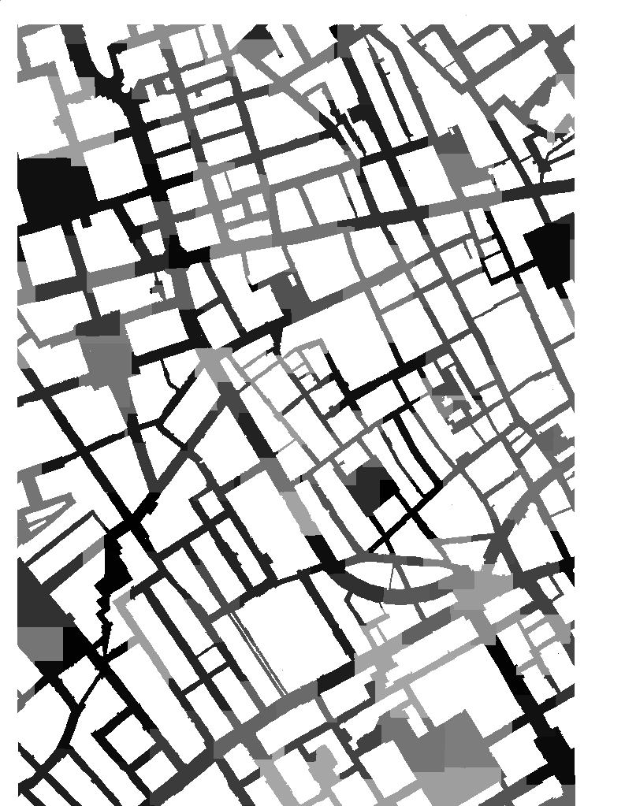
Notes:
Figure 12.21 (Bottom Row)

Slide 79
Other Strategies
Active area of research: given a partitioning, how to reallocate users or regions to servers as load changes
Local refinement of scope of server

Slide 80
Notes:
Figure 12.24

Slide 81
Notes:
Figure 12.25

Slide 82
PEER TO PEER

Slide 83
Peer to Peer
A very live challenge: how can peer to peer networks scale up to very large numbers
Key to this is how to distribute awareness management
A secondary issue is how to “bootstrap”: how does a user find their local users?

Slide 84
Larger Peer to Peer Context
Enormous work in networking community on generic large scale peer to peer databases
Key technologies
Distributed hash tables: a way of storing data sets across multiple hosts but ensuring fast (O(logN)) access to any data item
Application-level routing: a mechanism for supporting group peer to peer communication without any underlying network support

Slide 85
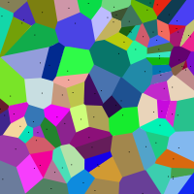
Within a NVE Context
Very active line of research
For example, can one maintain a set of closest peers with something similar to a Voronoi Tessellation?
If peers can identify their Voronoi Cell, they can identify their neighbours.
New clients can walk the cells to get to find their true neighbours

Slide 86
Standards

Slide 87
Potential Standards
OpenSim project shows that its possible to construct user-maintained “grids” of servers
OpenSim implements the server functionality of Second Life. It complements the open source version of the viewer from Linden Labs
NVEs in browsers will emerge from WebSockets/WebGL

Slide 88
Open Standards
X3D hasn’t reach critical mass, may be over-taken by WebGL (though you can use X3D on WebGL)
Notably different requirements than MPEG which has networking components including streamed 3D (based on VRML97)
?

Slide 89
Summary

Slide 90
Plenty of tools and options to support your NG or NVE project
Security is a big challenge if you can’t get your users on to a VPN
Other facilities require more infrastructure and are very domain specific
Plenty of research issues: thin clients being a wild card at the moment

Slide 91
Closing Remarks

Slide 92
Much More to Study
Nothing like hands on experience to reveal why Networked Graphics is a unique field
As a field, needs to learn lessons from Internet standards and web standards
An NVE or NG has a complex set of requirements and thus networking needs
BUT lots of the technology is readily available in middleware

