Slide 1
Part 3: Latency Scalability
Anthony Steed

Slide 2
Latency
- Mitigation strategies
- Playout delays, local lag and dead reckoning
Scalability
- Management of awareness
- Interest specification
- Server partitioning

Slide 3
Latency

Slide 4
Latency
- Mitigation strategies
- Playout delays, local lag and dead reckoning

Slide 5
DUMB CLIENT AND LOCKSTEP SYNCHRONISATION

Slide 6
Naïve (But Usable) Algorithms
Most naïve way to ensure consistency is to allow only one application to evolve state at once
One application sends its state, the others wait to receive, then one proceeds
Is a usable protocol for slow simulations, e.g. games
Not that slow – moves progress at the inter-client latency
Potentially useful in situations where clients use very different code, and where clients are “un-predictable”

Slide 7
Total Consistency (Alternating Execute)
Client A
Client B
T = t
Acknowledge every update
Propagation delay is 100ms

Slide 8
Total Consistency (Alternating Execute)
Client A
Client B
T = t + 50ms

Slide 9
Total Consistency (Alternating Execute)
Delta T
Client A
Client B
T = t + 50 ms + 100 ms
Delta T (latency) is 100ms

Slide 10
Total Consistency (Alternating Execute)
Client A
Client B
T = t + 50ms + 100ms + 50ms

Slide 11
Total Consistency (Alternating Execute)
Delta T
Client A
Client B
T = t + 50ms + 100ms + 50ms + 100ms
T = t + 300ms
After 300ms Client A may move again!!!

Slide 12
Lock-Step (1)
If all clients can deterministically on the input data
Then a more useful form lock-step for NVEs & NGs is that everyone exchange input, proceed once you have all the information from other clients
But for many simulations, each step is only determined by user input, so can just communicate input

Slide 13
DOOM (1) – iD Software
Doom Client_{A}
Doom Client_{C}
Read
Input
Read
Input
Receive
Input
Receive
Input
Doom Client_{B}
Simulate
Simulate
Read
Input
Rendering
Rendering
Receive
Input
Simulate
Rendering

Slide 14
Lock-Step (2)
If the simulation is complex or non-deterministic, use a server to compute the state
Clients are locked to the update rate of the server
Note that own input is delayed

Slide 15
Quake (1 Pre-QuakeWorld) – iD Software
Quake Client_{A}
Quake Server
Quake Client_{B}
Mouse
Keyboard
Mouse
Keyboard
Read
Input
Receive
Input
Read
Input
Rendering
Simulate
Rendering
Draw
Lists, Game State
Draw
Lists, Game State
Notes:
Figure 11.5

Slide 16
CONSERVATIVE SIMULATIONS

Slide 17
Conservative Simulations
Lock-step are simple examples of conservative simulations
Usually, there is no side-effect of the event you were waiting for
E.G. in Quake, a lot of the time the other player’s position is not important
Why wait for events? Why not just proceed
Answer is that you diverge IF you got shot
However, for many simulations you can decouple event sequences

Slide 18
Client_{A}
Client_{B}
Message Queue
Client_{C}
Message_{I}
Client=B Time=11.1
Message_{I+1}
Client=C Time=13.5
Message_{I+2}
Client=B Time=13.6
Message_{I+3}
Client=C Time=18.0
Message_{I+4}
Client=D Time=18.2
Client_{D}
In a conservative simulation, events can be played out, if the simulation can know that another event cannot precede the ones it wants to play out. In this case the first three messages can be played out, but the fourth and fifth cannot.
Notes:
Figure 11.7

Slide 19
Notes
Sufficient for many simulations
Also known as pessimistic simulations
Lots of theory about this: deadlocking, Chandy/Misra/Bryant lookahead null message algorithm
See: Fujimoto, R. (2000) Parallel and Distributed Simulation Systems

Slide 20
TIME

Slide 21
Time
Real-time synchronization needs a notion of time
IF every event could be time stamped you could accurately reconstruct the recent past
In reality clocks on machines can not be synchronized
Can get close with Network Time Protocol
Still not sufficient, applications tend to measure inter-client latency using round-trip times

Slide 22
Virtual Time
Sometimes it is sufficient to be able to order events
Lamport’s Virtual Time is really an event counter
An event can indicate which events caused it, and which it depends on
Thus, e.g. say Event_{Explode} caused Event_{Fire}
If Event_{Explode} says “Event_{Fire} caused me” then anyone who has Event_{Explode} waits for Event_{Fire}
This can be implemented for simple situations with just incremental counting (Event_{N+1} is held until Event_{N} is played)

Slide 23
Event_{Explode}
Client_{A}
Event_{Fire}
Client_{B}
Client_{C}
Event_{Explode} is delay at Client_{C} until after Event_{Fire}
A causal ordering scheme prevents Client_{C} from seeing an explosion before the fire event that caused it. In this case, the timeline and the ticks on the timeline only serve to indicate the passage of wall clock time, they don’t indicate time steps.
Notes:
Figure 11.8

Slide 24
For Large Simulations
Practically this can be achieved with vector clocks
Each simulation keeps an event order of the events it received, and then states which events it had received when it generated an event

Slide 25
Event_{Explode} (1,1,0)
Event_{Explode} (2,1,0)
Client_{A}
Event_{Fire} (0,1,0)
Client_{B}
Event_{Fire} (2,1,1)
Client_{C}
Notes:
Figure 11.9

Slide 26
OPTIMISTIC ALGORITHMS

Slide 27
Optimistic Algorithms
Conservative simulations tend to be slowed paced
Optimistic algorithms play out events as soon as possible
Of course, this means that they can get things wrong:
They may receive an event that happened in the past
To fix this they rollback by sending UNDO events
For many simulations UNDO is easy (just move something)

Slide 28
Lock Door
t₀
Open
Door
t₁
Close
Door
Add
Zombies
t₂
Remove
Zombies
t₃
t₄
Client_{A}
Client_{B}
Client_{C}
Notes:
Figure 11.10

Slide 29
CLIENT PREDICT AHEAD

Slide 30
Predict Ahead
A form of optimism: assume that you can predict what a server (or another peer) is going to do with your simulation
Very commonly applied in games & simulations for your own player/vehicle movement
You assume that your control input (e.g. move forward) is going to be accepted by the server
If it isn’t, then you are moved back Note this isn’t forwards in time but a prediction of the current canonical state (which isn’t yet known!)

Slide 31
Move?
P₀ _{to} P₁
P₀
P₁
Move?
P₁ _{to} P₂
Move
P₀ _{to} P₁
P₁
P₂
P₀
P₁
Move?
P₂ _{to} P₃
Move
P₁ _{to} P₂
P₂
P₃
P₁
P₂
Move?
P_{3 to} P₄
Move
P₂ _{to} P₃
P₃
P₄
P₂
P₃
Client_{A}
Server
Notes:
Figure 11.11

Slide 32
Move?
P₀ _{to} P₁
P₀
P₁
Move?
P₁ _{to} P₂
Move
P₀ _{to} P₁
P₀
P₁
P₁
P₂
Move?
P₂ _{to} P₃
FailMove
P₁ _{to} Q₁
P₁
P₂
P₃
Q₁
Q₁
FailMove
P₁ _{to} Q₁
Q₁
P₂
P₃
Client_{A}
Server
Notes:
Figure 11.12

Slide 33
Notes:
Figure 11.13

Slide 34
EXTRAPOLATION ALGORITHMS

Slide 35
Extrapolation Algorithms
Because we “see” the historic events of remote clients, can we predict further ahead (i.e. in to their future!)
This is most commonly done for position and velocity, in which case it is known as dead-reckoning
You know the position and velocity at a previous time, so where should it be now?
Two requirements:
Extrapolation algorithm: how to predict?
Convergence algorithm: what if you got it wrong?

Slide 36
Dead Reckoning: Extrapolation
1st order model
2nd order model

Slide 37
When to Send Updates
Note that if this extrapolation is true you never need to send another event!
It will be wrong (diverge) if acceleration changes
BUT you can wait until it diverges a little bit before sending events
The sender can calculate the results as if others were interpolating (a ghost), and send an update when the ghost and real position diverge

Slide 38
1st Order Model

Slide 39
2nd Order Model

Slide 40
t₂
t₁
t_{o}
a) Player model sending three
updates
b) Ghost model path without
blending
c) Old ghost model and new ghost
model at t₁

Slide 41
Convergence Algorithm
When they do diverge, you don’t want the receiver to just jump: smoothly interpolate back again
This is hard:
Can linearly interpolate between old and new position over time, but vehicles don’t linearly interpolate (e.g. would mean slipping

Slide 42
d) Blending between the old ghost and new ghost
over several frames
e) Ghost model path with blending

Slide 43
Convergence Algorithm
So you could steer the vehicle to correct its own position
This has frequency instabilities
Deals badly with obstacles as the interpolated path isn’t the same as the real path

Slide 44
Old ghost t₀
New ghost t₀+t_{Δ}
t₀
New ghost t₀
a) Old ghost position at t₀, new ghost position at t₀ and
new ghost position at t₀+t_{Δ}
b) Dotted line shows the planned path to
reach the target position and direction

Slide 45
Update at t₀
Update at t₁
a) Player model showing the timings of dead-reckoning updates at the peaks of a periodic motion

Slide 46
Player model update at t₀
Extrapolation of player model
Convergence path
Correct player model path
Ghost model location at t₀
b) On arrival of an update message, the ghost model plans to converge the current ghost model position with an extrapolation of the received position

Slide 47
c) On the next update message the ghost model is out of phase with the player model. T

Slide 48
t₁
t_{o}
Player model update at t₁
Path of ghost model after update at t₀
a) Player model showing the object avoiding the wall
b) After the update at t1 the ghost model cannot converge

Slide 49
INTERPOLATION, PLAYOUT DELAYS AND LOCAL LAG

Slide 50
Interpolation
Extrapolation is tricky, so why not just interpolate?
Just delay all received information until there are two messages, and interpolate between them
Only adds delay equal to the time between sending packets

Slide 51
t₁
P₁
t₂
P₂
P₃
t₃
P₄
t₄
Sender
Receiver

Slide 52
t₀
t₁
t₂
t₃
P₀
P₁
P₂
P₃
Interpolate P₀→P₁
Playout delay

Slide 53
Non-Linear Interpolation
Need to consider several aspects
Object movement is not linear, so could use quadric, cubic, etc. by keeping three or more updates

Slide 54
t₁
P₁
t₂
P₂
P₃
t₃
P₄
t₄
t₅
t₆
Sender
Receiver

Slide 55
Playout Delays
Note that jitter is not uniform, you need to be conservative about how long to wait (if a packet is late you have no more information to interpolate, so the object freezes)
NVEs and NGs thus sometimes use a playout delay
Note that if you use a playout delay on the clients own input, then all clients will see roughly the same thing at the same time!
A strongly related technique is bucket synchronisation, pioneered in the seminal MiMaze

Slide 56
Playout Delay
t₀
t₁
t₂
t₃
Sender
P₀
P₁
P₂
P₃
Client_{A}
Client_{B}
Maximum latency
Interpolate P₀→P₁
Playout delay

Slide 57
Bucket Synchronization
t₀
t₁
t₂
t₃
t₄
Client_{A}
E_{A1}
E_{B1}
E_{B2}
Client_{B}
E_{C1}
E_{C2}
Client_{C}
Interval (Tα)
Playout delay (TΔ)

Slide 58
PERCEPTION FILTERS

Slide 59
Perception Filters
In these techniques, the progress of time is altered at different clients
Clients choose to predict ahead or delay playout depending on the meaning and their expected interaction

Slide 60
Client_{A}
Client_{B}

Slide 61
CASE STUDY: BURNOUT ™ PARADISE

Slide 62
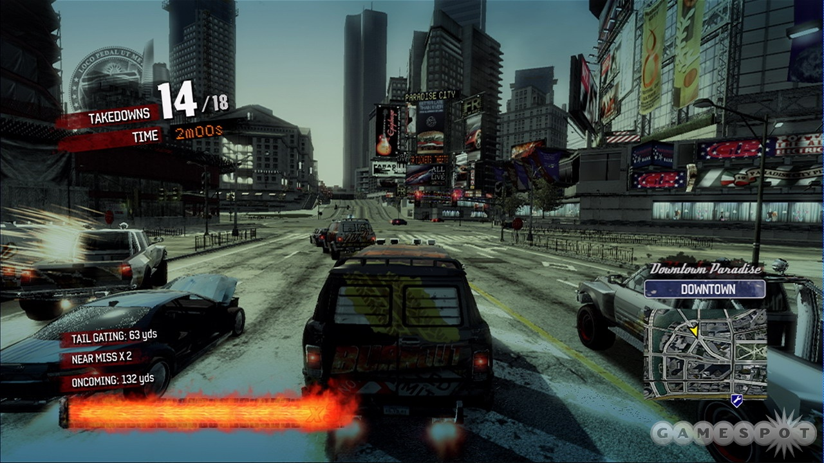
Burnout™ Paradise

Slide 63
Crashing sub-state
Driving sub-state (default)
Player 1 Timeline
Player 2 Timeline
Free Driving
State
Awards
State
(non-interactive)
Race start announcement
Awaiting Results State
(non-interactive)
Race start
Time
Race State

Slide 64
Scalability

Slide 65
Scalability
- Management of awareness
- Interest specification
- Server partitioning

Slide 66
Goals for SCalability

Slide 67
Interest Specification
A user is NOT an omniscient being
A user is NOT interested in every event
A client is NOT able to process everything
Just give each client enough to instil the user’s illusion of an alternate reality
Interest: visibility, awareness, functional, …
Network and computational constraints

Slide 68
Awareness Categories
Primary awareness
Those users you are collaborating with
Typically near by, typically highest bandwidth available
Secondary awareness
Those users that you might see in the distance or nearby
Can in principle interact with them within a few seconds by movement
Tertiary awareness
All other users accessible from same system (e.g. by teleporting to them)

Slide 69
System Goals
Attempt to keep
overall system utilization to a manageable level
client inbound bandwidth at a manageable level
client outbound bandwidth to a manageable level
To do this
Have clients discard received information
Have the system manage awareness
Have clients generate information at different levels of detail

Slide 70
Managing Awareness
A complex distributed problem
Users’ expressions of interest in receiving information balanced against system’s and other clients’ capabilities
Awareness scheme is partly dependent on the networking architecture, but most awareness management schemes can be applied to different architectures
Spatial layout is the primary moderating factor on awareness

Slide 71
Application
Message
Filtering
Application
Filter on
Send
Message
Routing
Message
Routing
Filter on
Receive
Network
Routing
Network
Routing
Network
Routing
Network
Routing
Network
Routing
Notes:
Figure 12.19

Slide 72
Spatial Partitioning

Slide 73
Spatial Partitions
Global Partitions
Static Grid
Hierarchical Grid
Locales
Local Partitions
Aura
Visibility
Nearest Neighbours

Slide 74
Global Partitions: Static Cells
1 Cell = 1 Group
Hexagon regular shape
Tied into the grid – static
Send current cell
Receive neighbours
Any architecture (distributed)

Slide 75
Global Partitions: Hierarchal Grid
1 Cell = 1 Group
Square cells
Send current cell
Receive current cell
Any architecture (distributed)
Exceeds threshold, expand
Threshold = 5

Slide 76
Global Partitions: Irregular
Notes:
Figure 12.8

Slide 77
Global Partitions: Locales
1 locale = 1 group
Locale is arbitrary shape
Locale placement is static
Associated transform matrix
Any architecture (distributed)

Slide 78
Global Partitions: Locales
1 locale = 1 group
Locale is arbitrary shape
Locale placement is static
Associated transform matrix
Any architecture (distributed)

Slide 79
Global Partitions: Locales
1 locale = 1 group
Locale is arbitrary shape
Locale placement is static
Associated transform matrix
Any architecture (distributed)

Slide 80
Local Partitions: Aura, Focus, Nimbus
Instead of grouping users by a global cell, group by their own interest overlap
Aura, Focus, Nimbus (Spatial Model) pioneered in the MASSIVE and DIVE systems

Slide 81
Local Partitions: Auras
Aura
Visual Focus
Visual Nimbus
Audio Nimbus
Audio Focus
Notes:
Figure 12.9

Slide 82
Local Partitions: Auras
User_{A}
User_{B}
Notes:
Figure 12.10

Slide 83
Local Partitions: Visibility
Line of sight
Entity visible = group
Client/Server
B
A
C

Slide 84
Local Partitions: Visibility
In real environment our focus is most severely limited by the physical environment: we can’t see around walls, we can’t hear (or see) over long distances

Slide 85
Local Partitions: Visibility
A
B
A
B
C
C
E
D
E
F
F
D
G
H
I
G
H
I
Cells
Portals
Notes:
Figure 12.12 (Top)

Slide 86
Spatial Partitions: Visibility
A | B | C | D | E | F | G | H | I
- | 1 | 1 | 0 | 1 | 0 | 0 | 0 | 0 | A
 | - | 1 | 1 | 1 | 1 | 0 | 0 | 0 | B
 |  | - | 0 | 1 | 1 | 0 | 0 | 0 | C
 |  |  | - | 1 | 0 | 1 | 1 | 0 | D
 |  |  |  | - | 0 | 1 | 0 | 0 | E
 |  |  |  |  | - | 0 | 0 | 0 | F
 |  |  |  |  |  | - | 1 | 1 | G
 |  |  |  |  |  |  | - | 1 | H
 |  |  |  |  |  |  |  | - | I
A
B
C
D
E
F
G
H
I
PVS_{A}
Full PVS
Notes:
Figure 12.12 (Bottom)

Slide 87
Spatial Partitions: Visibility
User₁
User₃
User₁
User₃
A
B
C
A
B
C
D
E
F
D
E
F
G
H
I
G
H
I
User₂
User₄
User₂
User₄
Notes:
Figure 12.14

Slide 88
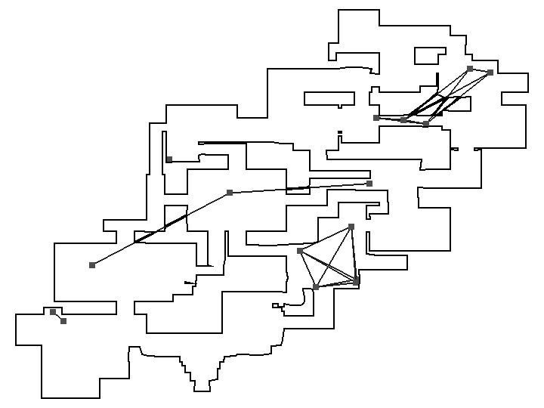
Spatial Partitions: Visibility
Notes:
Figure 12.15

Slide 89
Local Partitions: Nearest Neighbours
1 group = quorum
Computational/Network constraints
Client/Server

Slide 90
Local Partitions: Nearest Neighbours
1 group = quorum
Computational/Network constraints
Client/Server

Slide 91
Managing Handover

Slide 92
Server Interactions

Slide 93
Server Interactions
Server system introduce two big problems
How do two proximate users on adjacent servers interact?
Sometimes just not allowed – long twisty roads between server regions where you never meet other players
How do you actually hand over a player from one server to another
Need to move responsibility for interaction
Possibilities needs new network connections

Slide 94
Zone_{A}
Zone_{B}
Mirror_{AB}
Mirror_{BA}
User_{A}
User_{B}
Proxy of User_{A}
View on Server_{A}
View on Server_{B}
Notes:
Figure 12.22

Slide 95
Multi-Server Management

Slide 96
Practical Systems
A system such as Second Life™ utilizes a regular grid layout with one server per region
Regions are laid out on a mostly-contiguous map
However is a game session, far too many players want to access a specific game content
A game shard is a complete copy of a system, you connect to one system and see one player cohort
A game instance is similar, but is replication of a particular area (e.g. dungeon) to support one group of players within a cohort. Often created on demand.

Slide 97
Game Shards
Master
Server
1
2
Server_{A}
New Process
3
Server_{B}
Server_{C}
Server_{C}
Notes:
Figure 12.1

Slide 98
Game Regions
Server_{A}
Server_{D}
Master
Server
1
2
Server_{B}
Server_{C}
New Process
3
Notes:
Figure 12.2

Slide 99
Game Regions & Instances
Server_{A}
Master
Server
1
2
Server_{B}
New Process
3
4
Server_{C}
Server_{D}
Server_{C}
Server_{C}
Server_{C}
Notes:
Figure 12.3

Slide 100
Summary

Slide 101
Latency and dealing with time is a huge issue in NVEs and NGs with a variety of solutions
Conservative solutions v. rollback v.playout delays
Choice depends on game play
Scalability depends on a choice of awareness mechanism
Requires a logical scalability mechanism
Partitioning over users
Part 4 will look at application support, tools and future research issues

