Slide 1
Introduction to Networked Graphics
Part 5 of 5: Application Support & Recent Research

Slide 2
Overview
Goal:
To explain some other application issues and areas of recent research.
Topics:
Security and secure networks
Streaming
Cluster graphics
Thin clients
Peer to peer

Slide 3
Overview of Security Problems
Client_{C} may be interfering with traffic
Client_{A} may be running
Compromised code
Client_{C}
Server_{X} may have
exploitable bugs
Client_{A}
Server_{X}
Client_{B}
Client_{B} may be colluding
with Client_{A}
Notes:
Figure 13.1

Slide 4
Compromised Clients
A pervasive problem in gaming
E.G. notable problems with PSNet games after the PS3 master key was found allowing modified code on the PS3
For console gaming, hardware vendors try to lock down the hardware so only verified programs can run
For PC gaming, various detection techniques such as PunkBuster that detect malicious software
Countermeasure are typically ahead of amateur cheats but not professional cheats

Slide 5
Traffic Interference
Once data is on the network it is public
Various attacks
Packet injection
Packet hiding
Latency asymmetry
Some are mitigated by secure networks
Some servers specifically support secure protocols for certain actions
Notes:
For Packet Injection see the discussion between John Carmack and Richard Stalman regards the opening and exploitation of the Quake source code and protocol. O

Slide 6
Exploitable Server
Users need to trust server
User-hosted games are not accepted for ranking tournaments or cash games
Server might be have a loophole
E.G. Dupe bugs
Denial of service attack
E.G. Deny a win to an opponent by crashing the score server

Slide 7
User Collusion
A very difficult social situation to counter
E.G. Chip dumping
With this and all other security problems monitoring of exceptions is important
Players being too skillful
Unlikely plays
Game inventory inflation

Slide 8
Virtual Private Networks
Now very common for corporations and universities
Three reasons
Protection of internal services
Giving a different “appearance” to the outside world (e.g. ACM Digital Library)
Security of access from anywhere (no need to trust local network)
The very easiest way to protect a NVE or NG is to require someone go on a trusted VPN first
Incurs latency/bandwidth overhead of routing all information to the VPN access point first

Slide 9
Virtual Private Networks (VPNs)
Server_{X}
IP
Server_{Y}
Client_{A}
IP
Notes:
ClientA can’t contact ServerY directly. Probably a firewall prevents access.

Slide 10
VPNs and IPSec
Server_{X}
IP
Server_{Y}
IPSec
VPN
Gateway
Client_{A}
IP
Notes:
ClientA connects to a VPN using IPSec (IP Secure). All traffic between them is encrypted. ClientA can now reach ServerY, but additionally to any other server, it looks as if they are on the LAN that includes ServerY.

Slide 11
Different Uses of Streaming
Streaming Protocols
Streaming Animations
Streaming Geometry (i.e. incremental download)

Slide 12
Streaming Protocols
Audio/video transport is well developed on the Internet
However “well developed” means lots of competing solutions
Several plug and play libraries
Real-Time Protocol an extension of UDP to support streaming (though not all streaming protocols use it)
Can get RTP compliant libraries which enables streaming and receiving
E.G. AccessGrid, some VoIP solutions

Slide 13
Real-Time Protocol
Bits | 0 15 |  | 16 31
0-31 | Version, config, flags | Payload Type | Sequence Number
32-63 | Timestamp
64-95 | Synchronisation Source (SSRC) Identifier
96+ | Contributing Source (CSRC) Identifiers (Optional)
96+ | Header Extensions (Optional)
96+ | Payload Header
128+ | Payload Data
Notes:
Figure 13.4

Slide 14
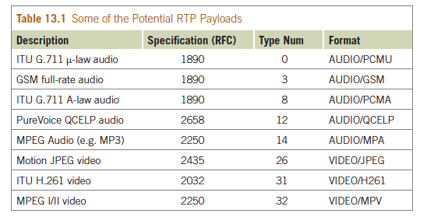
RTP Payloads
Notes:
Table 13.1

Slide 15
Streaming Animations
We have already looked at streaming positions and orientations of objects
However, a large class of objects are humans or animals (or aliens) which deform
Typically modeled from the graphics side as a skeleton
Animation is controlled by indicating which motion the character is in and the keyframe in that motion
Because motion is continuous (e.g. motion capture) information might only need to be sent > 1s

Slide 16
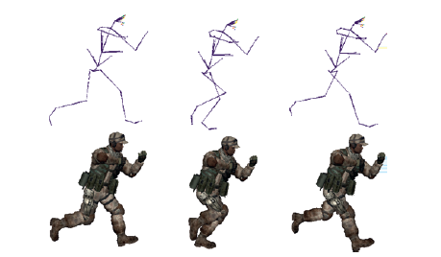
Examples of Keyframe Animation
Notes:
Figure 13.5

Slide 17
Streaming Geometry
Many NVEs use very large worlds which need to be downloaded because user modifiable or just vast
System needs to determine which parts of the models should be transferred
Typically done in a priority order from the viewpoint of the client, e.g. in increasing distance order
Two ways of doing this
Client-pull
Server-push

Slide 18
Server Push
PositionX
PositionY
Send A_{High}, B_{Low}
Position Z
Send B_{High}, C_{Low}
Send D_{Low}, E_{Low}
Client
Server

Slide 19
Client Pull
Fetch Index
Send Index
Fetch A_{High}, B_{Low}
Fetch B_{High}, C_{Low}
Send A_{High}, B_{Low}
Send B_{High}, C_{Low}
Client
Server

Slide 20
Clusters
Cluster graphics is a particular concern of Virtual Reality system designers
One GPU card generates one or two video to get maximum throughput, but we might need 4+ displays
Need to synchronize graphics at two levels
Synchronize graphics state on input to rendering
Need to synchronize video output

Slide 21
Layers of Sharing Graphics
Synchronize applications
Application
Application
Modifies scene graph
Copy scene graph
Scene Graph
Scene Graph
Render traversal
Copy render commands
Graphics Drivers
Graphics Drivers
Notes:
Figure 13.9

Slide 22
Tools
Copy render commands
E.G. Chromium – stream OpenGL commands over TCP/Ethernet, or other non-IP-based interconnects
Copy scene graph
E.G. OpenSG – stream an edit change list for a scene-graph
Synchronize applications
E.G. VRJuggler – isolate all input in to one (or more) C++ classes that can serialize themselves to the network, stream the resulting serializations.

Slide 23
Thin Clients
Might be considered “backwards” but graphics architectures go in circles, so why not networked graphics architectures
Render the graphics on a server, stream the results as video
Recent consumer examples: OnLive, OToy, GaiKai
However many OS vendors have such a functionality for supporting thin clients over LANs

Slide 24
Thin Clients
Very small installable on client, client doesn’t need to be high-powered (hence thin client, e.g. tablet)
Stream your controller input to server
Stream back video (e.g. 720p from OnLive) OR stream back window rendering code (X11, RDP, OpenGL derivatives)

Slide 25
Thin Clients: Pros & Cons
Main pro: install cost close to zero, immediate start
Main con(1): latency
No question that some actions (e.g. camera rotation) are very easily noticeable
BUT consider OnLive: the server can run both game client and game server
Multiuser might be fairer (to be investigated!)
Almost like playout delay via video!
(N.B. OnLive actual architecture not revealed)
Main con(2): bandwidth required

Slide 26
Peer to Peer
A live challenge: how can peer to peer networks scale up to very large numbers
Key to this is how to distribute awareness management
A secondary issue is how to “bootstrap”: how does a user find their local users?

Slide 27
Larger Peer to Peer Context
Enormous work in networking community on generic large scale peer to peer databases
Key technologies
Distributed hash tables: a way of storing data sets across multiple hosts but ensuring fast (O(log(N))) access to any data item
Application-level routing: a mechanism for supporting group peer to peer communication without any underlying network support

Slide 28
Within a NVE Context
Very active line of research
For example, can one maintain a set of closest peers with something similar to a Voronoi Tessellation?
If peers can identify their Voronoi Cell, they can identify their neighbours.
New clients can walk the cells to get to find their true neighbours

Slide 29
Summary
Plenty of tools and options to support your NG or NVE project
Security is a big challenge if you can’t get your users on to a VPN
Other facilities require more infrastructure and are very domain specific
Plenty of research issues: thin clients being a wild card at the moment

