Slide 1
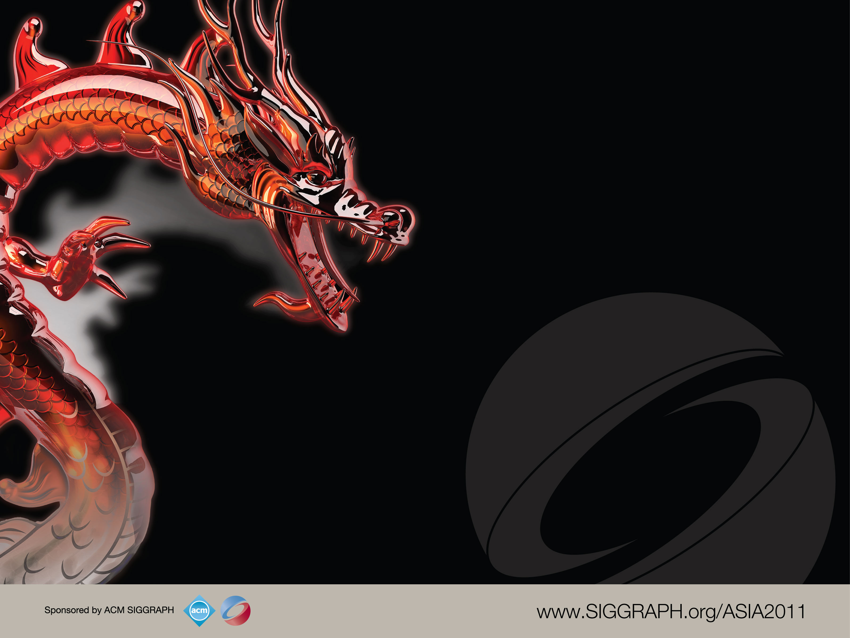
Introduction to Networked Graphics
Part 3 of 5: Latency

Slide 2
Overview
Goal:
To explain how latency impacts the decisions of how to ensure consistency. Latency implies that clients cannot all act the same way because they don’t have consistent information.
Topics:
Synchronising state with latent communications
Playout delays, local lag
Extrapolation and dead reckoning

Slide 3
Naïve (But Usable) Algorithms
Most naïve way to ensure consistency is to allow only one application to evolve state at once
One application sends its state, the others wait to receive, then one proceeds
Is a usable protocol for slow simulations, e.g. games
Not that slow – moves progress at the inter-client latency
Potentially useful in situations where clients use very different code, and where clients are “un-predictable”

Slide 4
Lock-Step (1)
If all clients can deterministically on the input data
Then a more useful form lock-step for NVEs & NGs is that everyone exchange input, proceed once you have all the information from other clients
But for many simulations, each step is only determined by user input, so can just communicate input

Slide 5
DOOM 1 – iD Software
Doom Client_{A}
Doom Client_{C}
Read
Input
Read
Input
Receive
Input
Receive
Input
Doom Client_{B}
Simulate
Simulate
Read
Input
Rendering
Rendering
Receive
Input
Simulate
Rendering

Slide 6
Lock-Step (2)
If the simulation is complex or non-deterministic, use a server to compute the state
Clients are locked to the update rate of the server
Note that own input is delayed

Slide 7
Quake 1 (Pre-QuakeWorld)
Quake Client_{A}
Quake Server
Quake Client_{B}
Mouse
Keyboard
Mouse
Keyboard
Read
Input
Receive
Input
Read
Input
Rendering
Simulate
Rendering
Draw
Lists, Game State
Draw
Lists, Game State
Notes:
Figure 11.5

Slide 8
Optimistic Algorithms
Conservative simulations tend to be slowed paced
Optimistic algorithms play out events as soon as possible
Of course, this means that they can get things wrong:
They may receive an event that happened in the past
To fix this they rollback by sending UNDO events
For many simulations UNDO is easy (just move something)

Slide 9
Lock Door
t₀
Open
Door
t₁
Close
Door
Add
Zombies
t₂
Remove
Zombies
t₃
t₄
Client_{A}
Client_{B}
Client_{C}
Notes:
Here two clients make events very close in time. ClientB doesn’t know that ClientA locked the door, so opens it. ClientC see the open door and releases zombies. However the temporally correct order would prevent the door opening. Thus ClientB has to undo its command. This then forces ClientC to do an undo too.

Slide 10
Client Predict Ahead
A form of optimism: assume that you can predict what a server (or another peer) is going to do with your simulation
Very commonly applied in games & simulations for your own player/vehicle movement
You assume that your control input (e.g. move forward) is going to be accepted by the server
If it isn’t, then you are moved back Note this isn’t forwards in time but a prediction of the current canonical state (which isn’t yet known!)

Slide 11
Move?
P₀ _{to} P₁
P₀
P₁
Move?
P₁ _{to} P₂
Move
P₀ _{to} P₁
P₁
P₂
P₀
P₁
Move?
P₂ _{to} P₃
Move
P₁ _{to} P₂
P₂
P₃
P₁
P₂
Move?
P_{3 to} P₄
Move
P₂ _{to} P₃
P₃
P₄
P₂
P₃
Client_{A}
Server
Notes:
Figure 11.11

Slide 12
Move?
P₀ _{to} P₁
P₀
P₁
Move?
P₁ _{to} P₂
Move
P₀ _{to} P₁
P₀
P₁
P₁
P₂
Move?
P₂ _{to} P₃
FailMove
P₁ _{to} Q₁
P₁
P₂
P₃
Q₁
Q₁
FailMove
P₁ _{to} Q₁
Q₁
P₂
P₃
Client_{A}
Server
Notes:
Figure 11.12

Slide 13
Extrapolation Algorithms
Because we “see” the historic events of remote clients, can we predict further ahead (i.e. in to their future!)
This is most commonly done for position and velocity, in which case it is known as dead-reckoning
You know the position and velocity at a previous time, so where should it be now?
Two requirements:
Extrapolation algorithm: how to predict?
Convergence algorithm: what if you got it wrong?

Slide 14
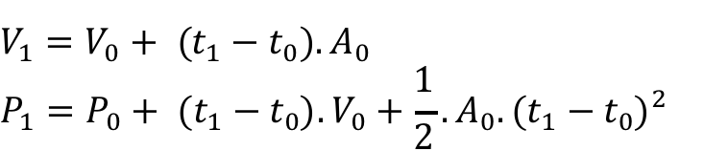
Dead Reckoning: Extrapolation
1st order model
2nd order model

Slide 15
When to Send Updates
Note that if this extrapolation is true you never need to send another event!
It will be wrong (diverge) if acceleration changes
BUT you can wait until it diverges a little bit before sending events
The sender can calculate the results as if others were interpolating (a ghost), and send an update when the ghost and real position diverge

Slide 16
1st Order Model

Slide 17
2nd Order Model

Slide 18
Convergence Algorithm
When they do diverge, you don’t want the receiver to just jump: smoothly interpolate back again
This is hard:
Can linearly interpolate between old and new position over time, but vehicles don’t linearly interpolate (e.g. could mean slipping or even going through obstacles)

Slide 19
Convergence Appears as Sliding Motion
Blending between the old ghost and new ghost
over several frames

Slide 20
Interpolation
Extrapolation is tricky, so why not just interpolate?
Just delay all received information until there are two messages, and interpolate between them
Only adds delay equal to the time between sending packets

Slide 21
Interpolation & Playout Delays
Extrapolation is tricky, so why not just interpolate?
Just delay all received information until there are two messages, and interpolate between them
Note that jitter is not uniform, you need to be conservative about how long to wait (if a packet is late you have no more information to interpolate, so the object freezes)
NVEs and NGs thus sometimes use a playout delay
Note that if you use a playout delay on the clients own input, then all clients will see roughly the same thing at the same time!

Slide 22
Playout Delay
t₀
t₁
t₂
t₃
Sender
P₀
P₁
P₂
P₃
Client_{A}
Client_{B}
Maximum latency
Interpolate P₀→P₁
Playout delay

Slide 23
t₁
P₁
t₂
P₂
P₃
t₃
P₄
t₄
Sender
Receiver
Notes:
Using a playout delay and linear interpolation, here we see that the receiver can interpolate the position of the sender’s entity. From t2 to t3 the receiver is moving the entity from p1 to p2. In practice the playout delay might be longer to accommodate more jitter or latency.

Slide 24
Non-Linear Interpolation
Need to consider several aspects
Object movement is not linear, so could use quadric, cubic, etc. by keeping three or more updates
Note that this causes more delay
However, if update rate is fast, the trade off is that movement is apparently a lot smoother

Slide 25
Non-Linear Interpolation
t₁
P₁
t₂
P₂
P₃
t₃
P₄
t₄
t₅
t₆
Sender
Receiver
Notes:
Here we use quadric interpolation. You need to have three points in order to interpolate. Thust at t4 the receiver can start to interpolate between the positions received from sender at t1 and t2. When they reach t5, they will be showing the position of the sender at t2

Slide 26
Summary
You can’t beat latency, so you need to deal with the consequences
Over LAN you can just do a lock-step or simple synchronisation scheme
Server can calculate all behaviours
Over a WAN you can’t live with the implied delays, so use optimistic schemes
Alongside optimistic schemes, one might delay playouts and interpolate historic events to ensure that every site see a similar state at the same time.

